Slide 1

The COPOD Algorithm and its Applications under Multiple Scenarios
CSIT5210 Project Presentation -- Group 02
BAI Qian, TONG Jinjian, YUAN Dian, WANG Weihong and YU Ximeng

Slide 2

Introduction

Slide 3
INTRODUCTION
__________________________________________________________________________________________
Related Knowledge
Implementation
Application
Inverse Sampling
Copula Description
COPOD Algorithm
Compute empirical copula
Output outliers
Image Application
Audio Application
Text Application
WANG, Weihong
Notes:
We will introduce this outlier detecting algorithm based on copula to you from the following three aspects

Slide 4
Related Knowledge
Inverse Sampling
Copula Description
COPOD Algorithm
Notes:
Now let us introduce the related knowledge to you.

Slide 5
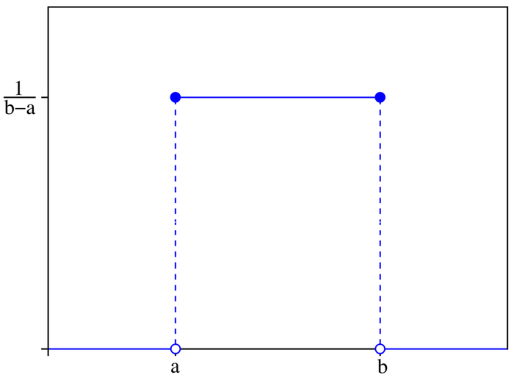
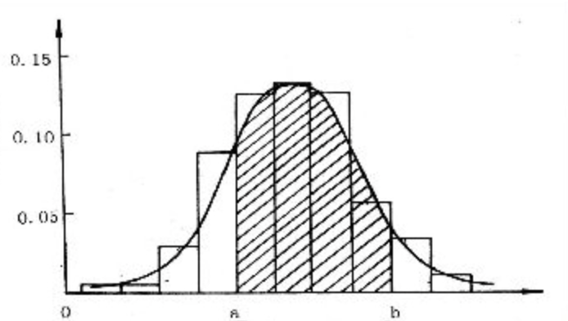

Random Generation
__________________________________________________________________________________________
If X is just a random variable, how can we use it to get a uniform distribution?
Simple Uniform Distribution
in python: random2.random( )
WANG, Weihong
Notes:
Look at the picture on the left, this is the simplest uniform diistribution. We can easily get a uniformly distributed random variable X from it. But (click) if this picture becomes the Gaussian distribution on the right, how can we use it to get random numbers following uniform distribution?

Slide 6
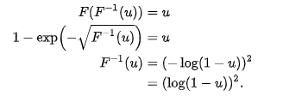
Inverse Sampling
__________________________________________________________________________________________
For any continuous random variable X, its cumulative distribution function is CDF(x) = P(X ≤ x), and Y = CDF(X) follows a uniform distribution.(Proof skip here.)
cumulative distribution function
reverse function
randomly select u from 0 to 1
calculate x
x =
WANG, Weihong
Notes:
So we use the inverse sampling. This method can be used to generate a random sample from the distribution when the cumulative distribution function of any probability distribution is known. For example, we have a distribution function like this. And we calculate its inverse function. We can use it to calculate X. | The Inverse sampling is used in the next copula function.

Slide 7
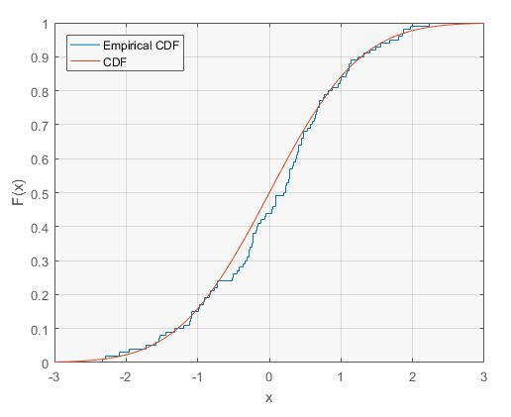
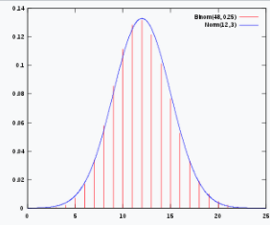
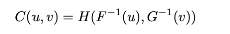
Copula Description
__________________________________________________________________________________________
Sklar theory:
F(x)
G(y)
binary joint distribution
H(x, y) = C(F(x) + G(y))
if H, F, G are know:
WANG, Weihong
Notes:
What copula means? copula allows us to calculate the joint distribution between variables through the marginal distribution of variables. In this example, if we know the F(x) and G(x), we can use copula to discribe their joint distribution.

Slide 8
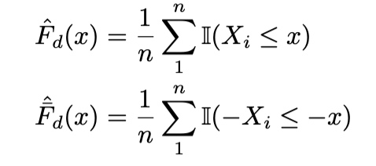
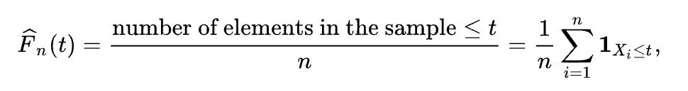
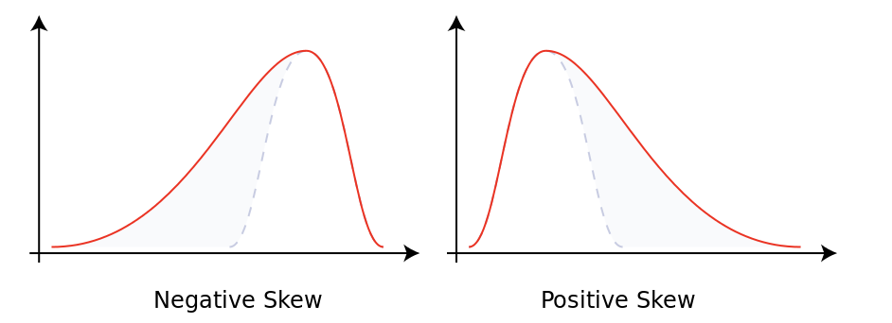
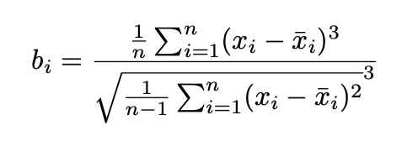
COPOD(Copula-Based Outlier Detection)
__________________________________________________________________________________________
Input: n ∗ d input dataset X
Output: Outlier score (label) for each data Xi(i = 1, ....n)
Step 1:
Fit empirical left tail ECDF(Empirical Cumulative Distribution Function) for each dimension.
Fit empirical right tail ECDF for each dimension.
Calculate skewness coefficient for each dimension.
BAI, Qian
Notes:
Now let's talk about COPOD, copula-based outlier detection. So how copod detect outlier with the copula ideas? Since we’ve already know copula allows us to calculate the joint distribution of multi-variables through the marginal distributions of each variable. We fit empirical cumulative distribution functions (ECDFs) as the marginal distributions or so called copula obsearvations, which you can find the defination here. And use the ECDFs to build up the copula function. And then compute outlier score to find the outlier.
COPOD is a three-stage algorithm. It takes the nd size data as input and output the outlier score. At the first stage, we compute the left tail ecdf and the right tail ECDF for each dimension. Also, We compute the skewness coefficient, which is a measure of asymmetry of the probability distribution for each dimension. You can find the computing function here.
In probability theory and statistics, skewness is a measure of the asymmetry of the probability distribution of a real-valued random variable about its mean. The skewness value can be positive, zero, negative, or undefined.

Slide 9
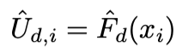
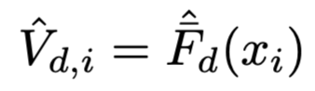
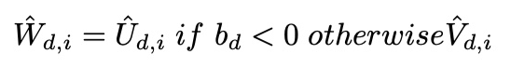
COPOD
__________________________________________________________________________________________
Step 2:
Compute the left tail empirical copula observations for each data record xi
Compute the right tail empirical copula observations for each data record xi
Calculate the skewness corrected empirical copula observations
Step 3:
Outlier score of X = the maximum of the negative log of the probability generated by the left tail empirical copula function, right tail empirical copula function and skewness corrected empirical copula function.
Outlier scores are between (0, +∞), the bigger O(Xi) is, the more likely Xi is an outlier. We can set threshold to find outlier which exceed the threshold or find top k% data record as outlier.
BAI, Qian
Notes:
Secondly, we use the ECDF to compute the copula observation, which indicates the approximation of the tail proability for each data. In details, we compute the left tail empirical copula observations, right tail empirical copula observations and skewness corrected tail probilities for each data. The skewness correction function is here! More specifically, when skwness is negative, it equals to left tail coupula observation.when skwness is positive, it output right tail coupula observation.
Thirdly, we set the maximum of the negative log of the probability generated by the left tail empirical copula, right tail empirical copula and skewness corrected empirical copula as outlier score to find the outlie.Outlier scores are between (0, +∞), the bigger O(Xi) is, the more likely Xi is an outlier. Then we can find the outlier whose outlier score is larger than threshould.

Slide 10
Implementation
Compute empirical copula
Output outliers

Slide 11
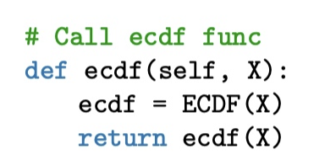
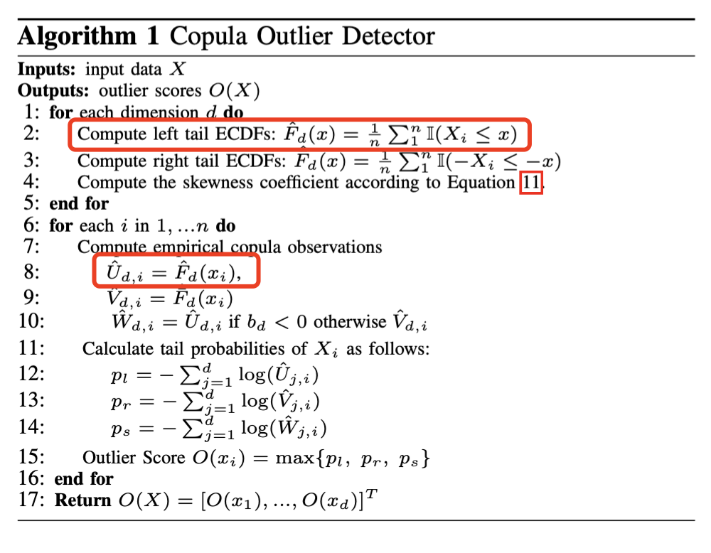
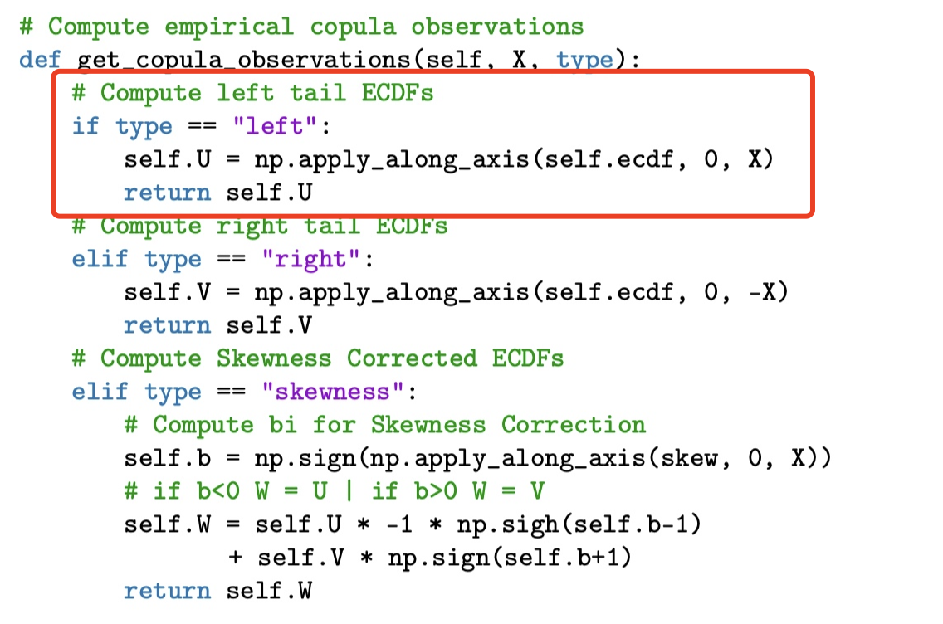
Implementation -Compute Left Tail Empirical Copula
__________________________________________________________________________________________
BAI, Qian
Notes:
In my part, since skewness and ecdf are both very classic and simple statistical models. I directly used the functions in pyhon libraries to calculate ecdf and skewness. In the ecdf(self, X) function, I call the ecdf function in statsmodels librabry. For the get_copula observations function. Different empirical copula observations are calculated according to different input types. For example, the function output the empirical copula observations of left tail ecdf when input is “left”.

Slide 12
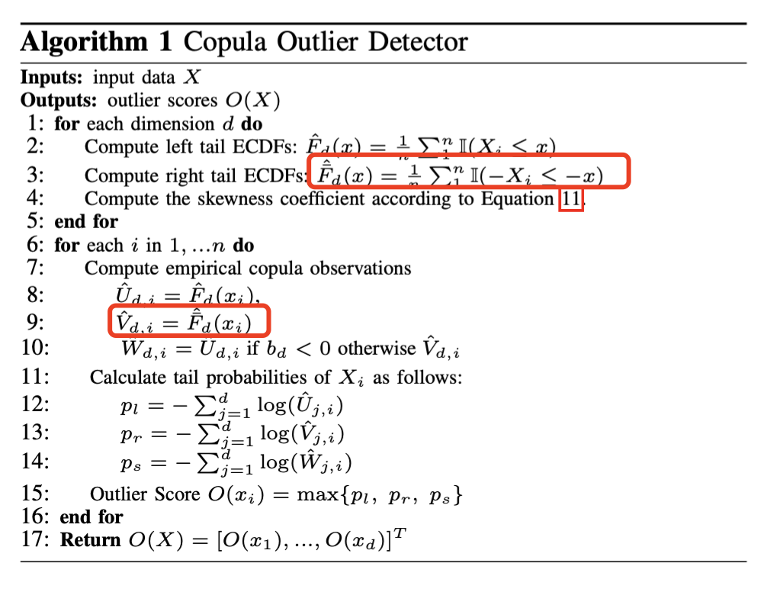
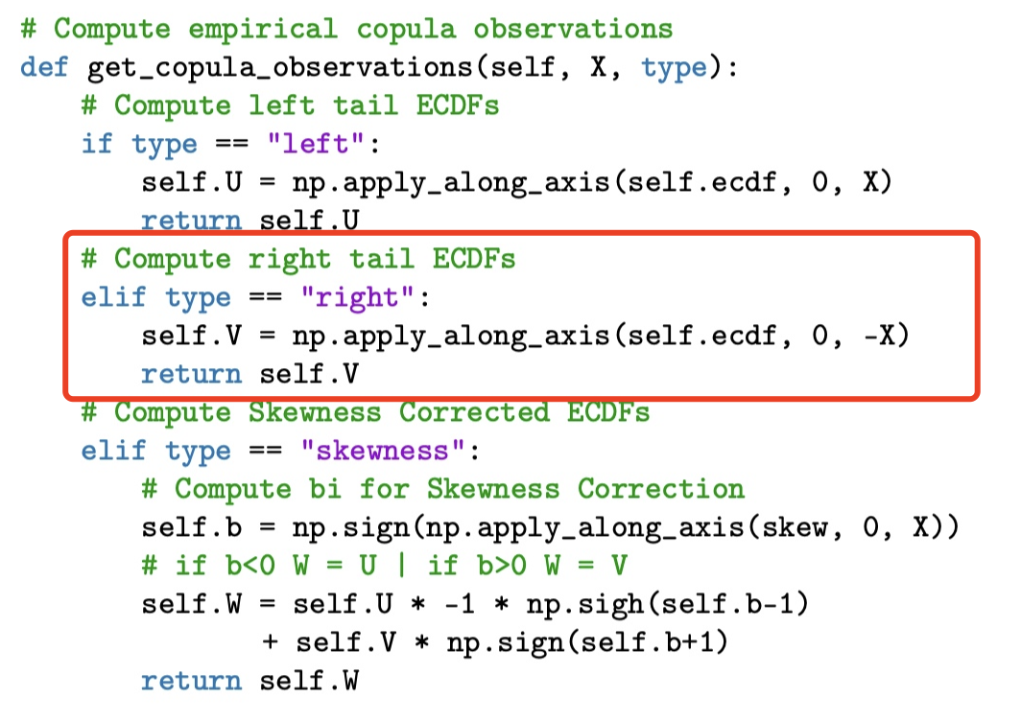
Implementation -Compute Right Tail Empirical Copula
__________________________________________________________________________________________
BAI, Qian
Notes:
The function output the empirical copula observations of right tail ecdf when input is “right”.

Slide 13
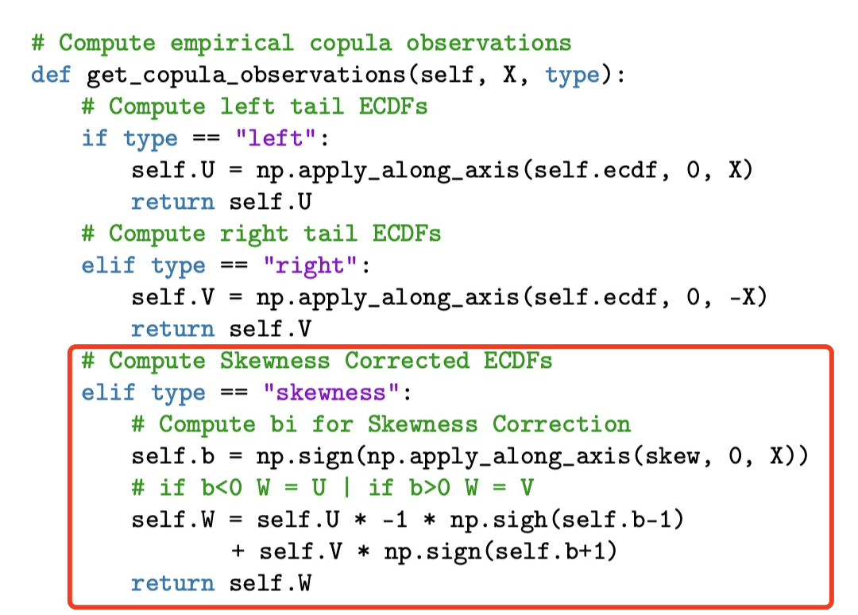
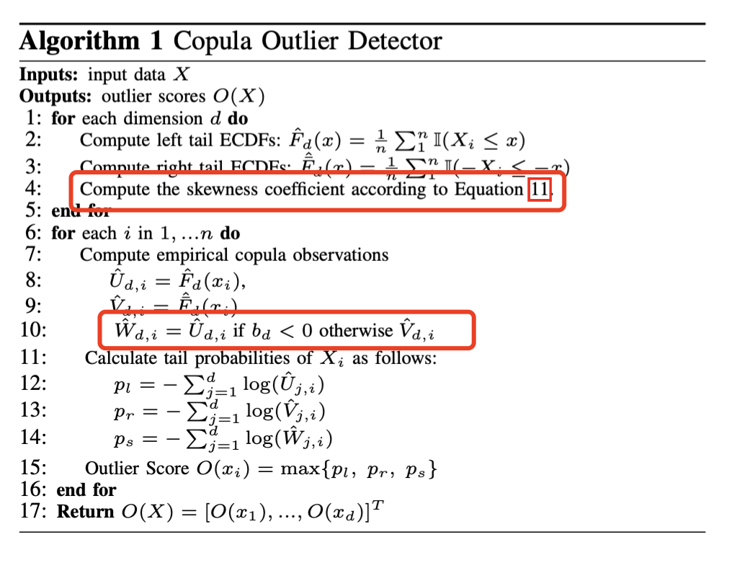
Implementation -Compute Skewness Corrected Empirical Copula
__________________________________________________________________________________________
BAI, Qian
Notes:
This function output the copula obsearvation skewness correted ecdfs when input is “skewness”. That’s all for me. Thank you.

Slide 14
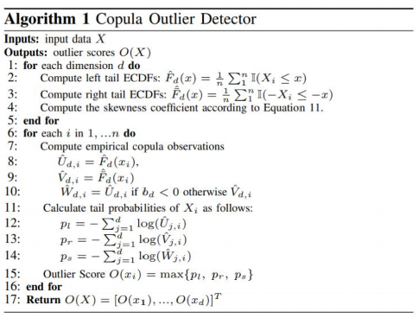
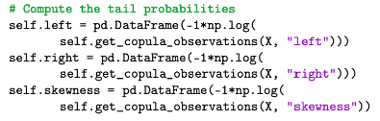
Implementation - Compute the tail probabilities
__________________________________________________________________________________________
Why we use log here?
e.g. -log(0.01) = 6.64
WANG, Weihong
Notes:
And then we compute the tail probabilities. Why we use log here? It is because the result of the tail probability is too small, we need to avoid diminishing tail probabilities. When there is a very small decimal, we use log to get a relatively large value

Slide 15
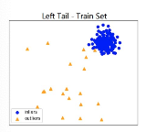
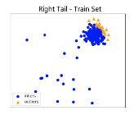
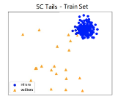
Implementation - Choose the greatest tail probability
__________________________________________________________________________________________
max(pl, pr, ps) = max(pl, pr)
❓
WANG, Weihong
Notes:
Then we have to choose the greatest tail probability. In their paper, they just select the maximum of pl, pr and ps. And the value of ps is equal to either pl or pr. So max(pl, pr, ps) is equal to max(pl, pr). (click）
If we just use this equation, the outlier score O(x) is just based on whether the tail probability of being on the left or on the right is larger. And the skewness correction doesn't seem to have an effect although it is correct in the above picture. I think we can do some optimization here.

Slide 16
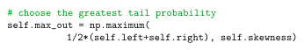
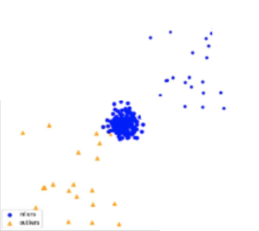

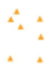

Implementation - Choose the greatest tail probability
__________________________________________________________________________________________
Optimization:
out = max(pl, pr, ps)
out = max( ½*(pl + pr), ps)
❓
Here, b < 0, then ps = pl.
And pl < pr
out = max(pl, pr, ps) = max(pl, pr)
out = pr
out = max(½ *(pl + pr), pl)
pl < out < pr
WANG, Weihong
Notes:
But if we change to such a distribution, the overall distribution is more skewed to the right, so p skewness equals to p left.
we did not adopt the process described in the paper in our implementation. We modified it to calculate the average value of left and right, then compare with skewness to take the maximum value.
I think this is the application of the skewness correction to the algorithm.

Slide 17
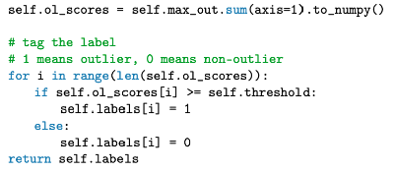
Implementation - Tag the label and output
__________________________________________________________________________________________
1 means outlier, 0 means non-outlier, and then return the result.
WANG, Weihong
Notes:
we compare the scores with the threshold.

Slide 18
Application
Image Application
Audio Application
Text Application
Notes:
Now we have a brief understanding for the rationale behind COPOD, we want to explore the performance of this outlier detection algorithm in real life. To test it under multiple scenarios, our team came up with 3 possible implement directions and has concrete experiments for each one. Those 3 directions are image, audio, and text.

Slide 19

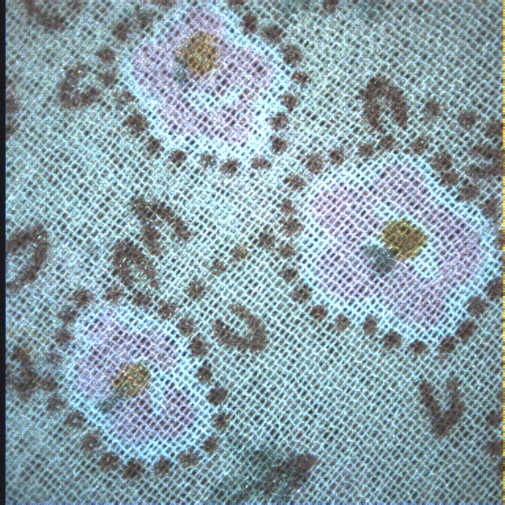
Image Application
__________________________________________________________________________________________
Dectection of outliers for fingerprint recording, including:
distorted fingerprints
random cloth patterns
TONG, Jinjian
Notes:
The scenario we choose is the detection of outliers for fingerprint recording. When we record out fingerprints, we want to system only record valid fingerprints, and warn us when it receives an outlier
In this experiment, the outliers are defined as distorted fingerprints and random cloth patterns

Slide 20
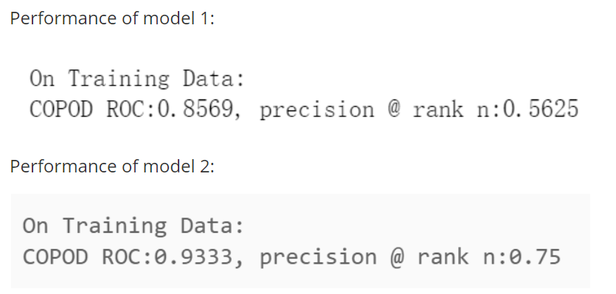
The 2 toy models
__________________________________________________________________________________________
Model 1:
inliers: 128 fingerprints
outliers: 32 distorted fingerprints
Model 2:
inliers: 128 fingerprints
outliers: 32 cloth patterns
 | Model1 | Model2
False + | 14 | 8
False - | 14 | 8
TONG, Jinjian
Notes:
I started with 2 toy models on small datasets. The inliers for both model are 128 fingerprints, while the outliers for model1 are 32 distorted fingerprints, and for model2, they are cloth patterns. Here is the performance of these two models.
The ROC score here means the area under ROC curve, and the precision here indicates how many outliers are true outlier. As what they show, model2 obviously has better performance on its task than model1. So is the false positive and false negative here show. One possible explanation is that the outlier in model2 is far away from inliers, while it does not in model1
ROC curve is a curve in ROC-space where the x-axis is false positive rate, and y-axis is true positive rate. Our ROC score here actually means the area under this ROC curve. It’s a mean to evaluate the performance of model.

Slide 21
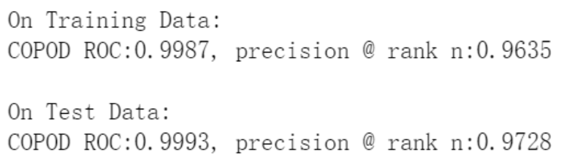
With more samples
__________________________________________________________________________________________
Inliers:
6000 fingerprint data from kaggle
Outliers:
Distorted fingerprints and cloth patterns, 1500 pictures in total
TONG, Jinjian
Notes:
Now let's use a larger dataset. We have 6,000 fingerprints, along with 1500 outliers, containing both distorted fingerprints and cloth patterns. And we have this result. It's surprisingly high. It got too high and I have to question if something is wrong. Therefore, I had several tests on this, including using the dataset from model1 and 2. Things went wrong when dealing with their inliers

Slide 22
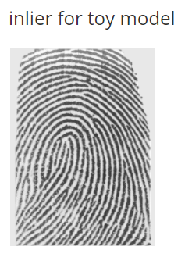
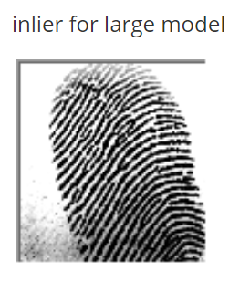
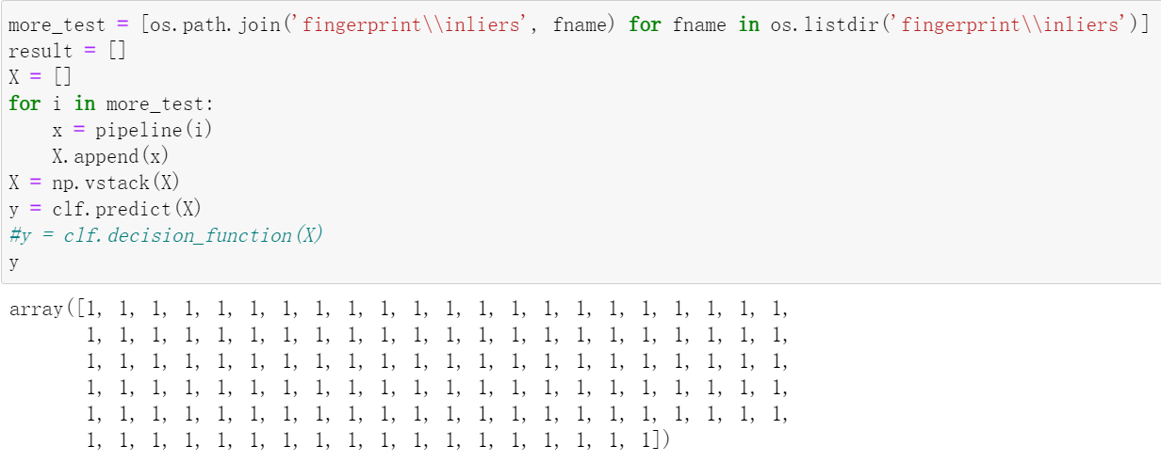
Something Went Wrong
__________________________________________________________________________________________
It is now identifying all fingerprints from toy models as outliers
TONG, Jinjian
Notes:
Here is an example. The model think the right one is inlier, and left one is outlier. They are definitely both valid, but our model overfits for the right picture.

Slide 23
Conclusion in Image scenario
__________________________________________________________________________________________
Future attention needed
It is easy and fast to apply and train
But do not have a nice performance on raw pictures
Need better understanding of inliers and outliers
inliers should be more general
tried to modify the ratio between inliers and outliers for training data in large model, no good result
distorted fingerprints might not be a good example of outlier
TONG, Jinjian
Notes:
Consider the dimension of our data, the training process is super fast
some preprocess such as feature extraction or edge detection might increase its performance

Slide 24






Audio Application
__________________________________________________________________________________________
Music Genre Outlier Detection:
brings better understanding to the music library
1. Album genre comparison
2. Distinct genre in album
Jazz Hip-hop
Instrumental
Electric, J-Pop
Post Rock
Vocal
Dian Yuan
Notes:
As for the audio related application, the scenario we proposed is the music genre outlier detection. A music player might want to improve the user experience by providing inter album-genre comparison and in-album distinct genre detection. Using COPOD as an approach to these requirements can bring us new understanding to its abilities.

Slide 25
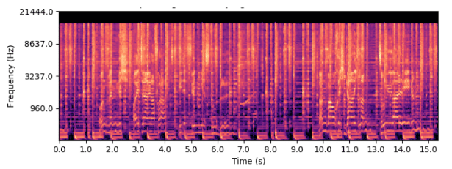
End-to-end Attempt
__________________________________________________________________________________________
We first made the end-to-end attempt
by fitting the mel spectrogram directly with COPOD
An example mel spectrogram
(2d-vector representation of amplitude and frequency over time)
Unsatisfactory results:
Need better representation for high-level genre information
Dian Yuan
Notes:
We first made an end-to-end attempt to the problem as an experiment. We calculated the mel spectrogram of music pieces, which is a 2d-vector representation of amplitude and frequency information over time. Then we fit the vectors directly with the COPOD. Unsurprisingly, this led to some unsatisfactory results. We believe the reason is that the music genre information is too high-level to be detected directly from low-level information like amplitude and frequency. Therefore, we need a better representation of the input.

Slide 26
Postprocessing Attempt
__________________________________________________________________________________________
MusicNN[1]: A pretrained neural network model for analyzing music genre
Outputs genre likelihood scores that are easy to work with
Reasonable inference speed on PC (< 10s per music piece)
We used COPOD to perform OD by fitting the outputs of MusicNN
Promising results
Fast fitting performance (almost instant)
[1] J Pons et al. https://github.com/jordipons/musicnn
Dian Yuan
Notes:
Our next attempt is the post-processing attempt based on the pretrained neural network model of genre classification called MusicNN. It takes the same mel spectrogram inputs and outputs vectors of genre likelihood scores between 0 and 1, which are much easier for the COPOD to work with. After fitting the outputs of the MusicNN model, we noticed a high fitting performance and got some very promising results.

Slide 27
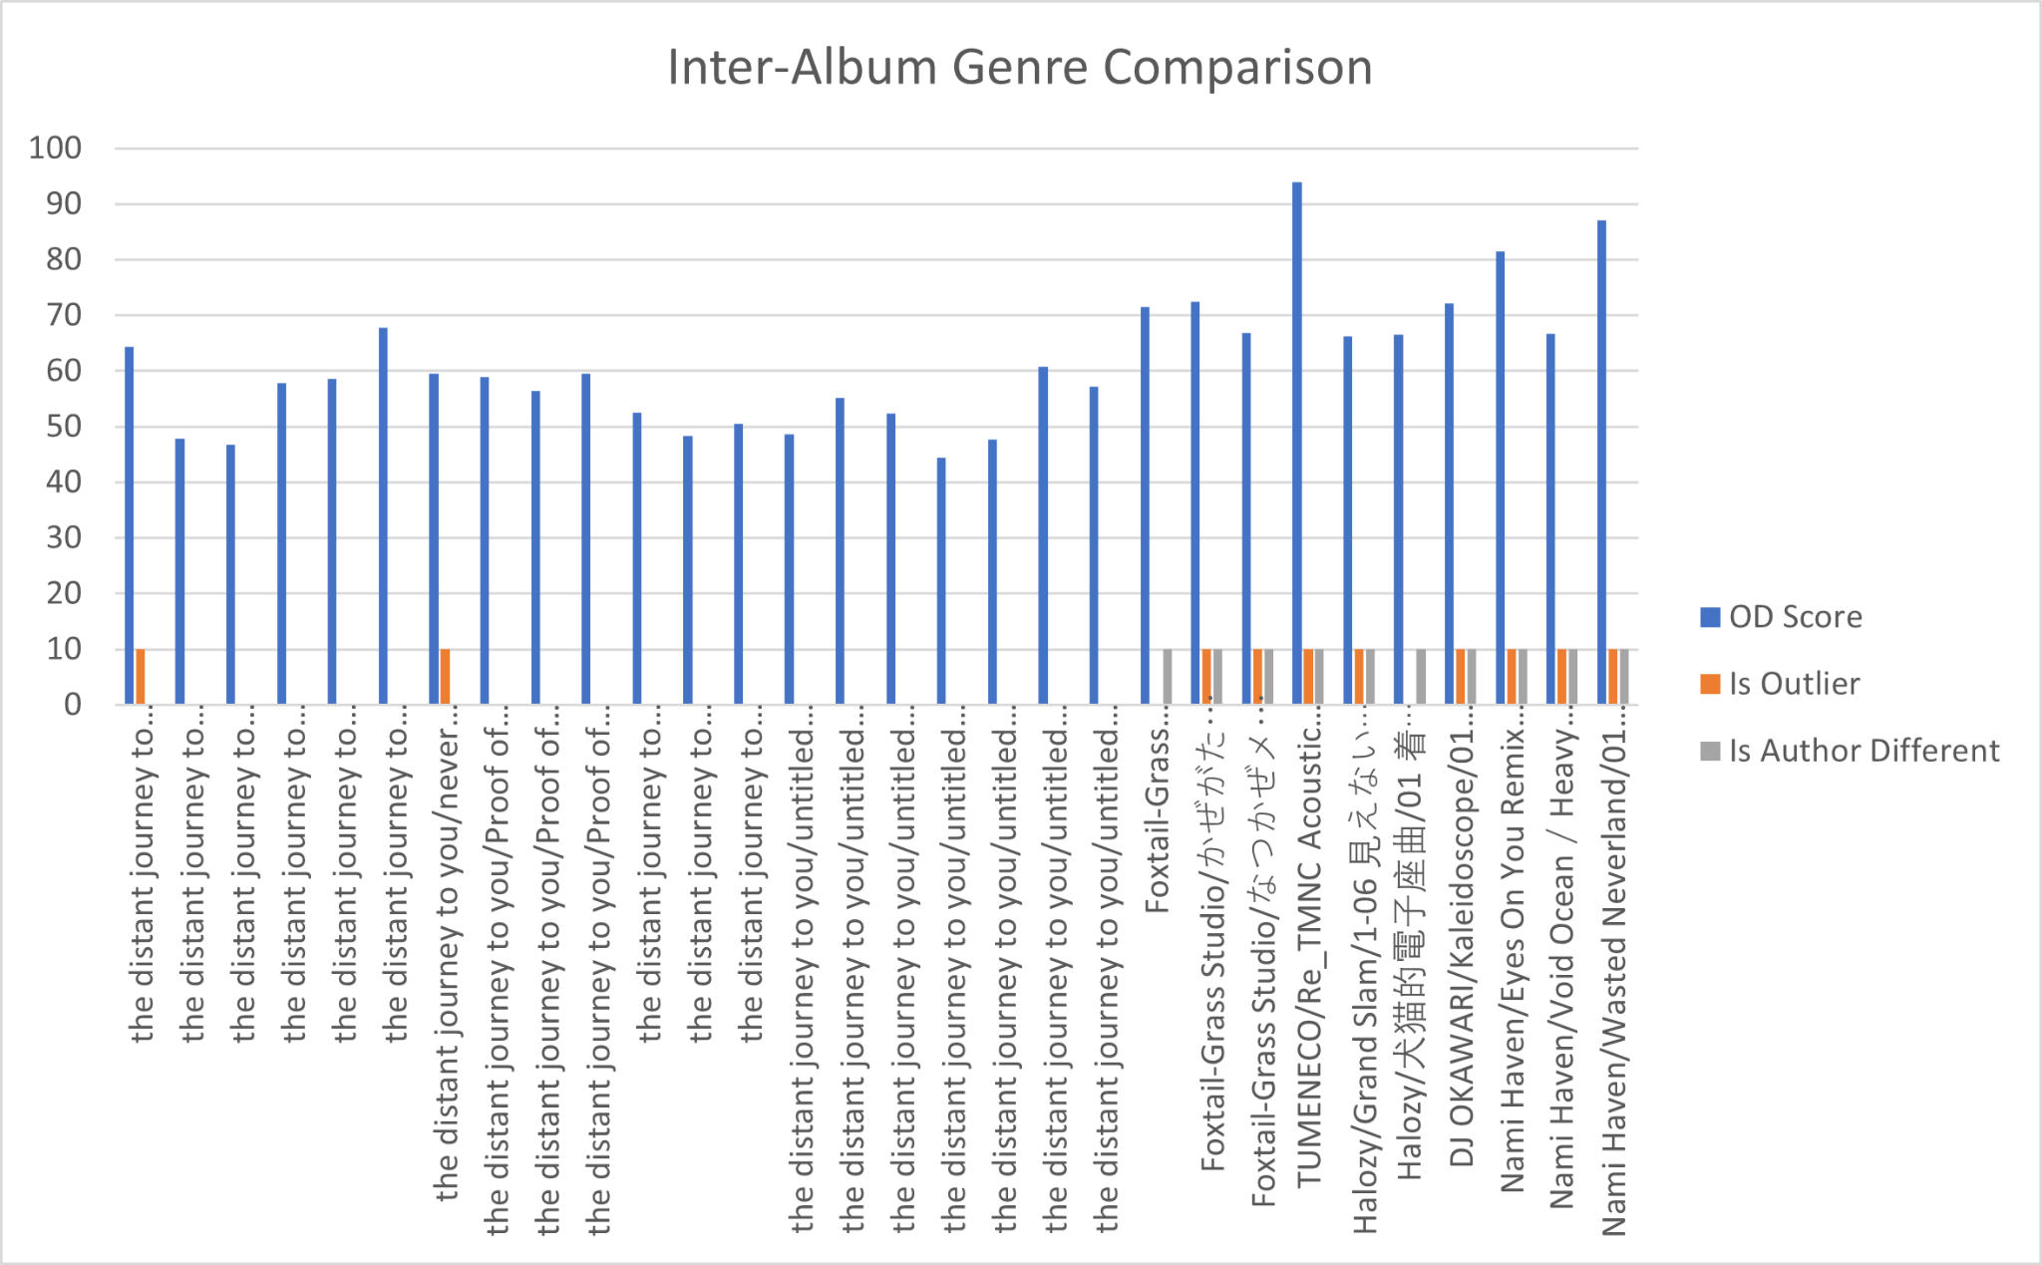
Postprocessing Result
__________________________________________________________________________________________
Music pieces from the same author are identified as inliers
While pieces from various other authors are identified as outliers
(around 90% percision for distinctively different genre)
Dian Yuan
Notes:
As this histogram has visualized, the genre likelihood vectors from music pieces of the same author led to lower outlier detection scores, or OD scores. And the music pieces randomly selected from other albums have higher OD scores and are detected as the outliers. The precision here can reach 90% for distinctively different genres.

Slide 28
Use Dimentional OD Score
__________________________________________________________________________________________
COPOD Algorithm: Sum of Dimentional OD Scores -> Total OD Score
Can be utilized to provide explainability
Apply use-case-specific modification
Weighting of Dimentional OD Score with Genre Likelihood Differences
It makes OD scores more reasonable
Greater difference of Genre Likelihood leads to larger OD scores
Dian Yuan
Notes:
Since the total OD scores of the COPOD algorithm are calculated from the dimensional OD scores, we also investigated the possibility to utilize these dimensional OD scores. One observation we had about the dimensional OD scores in this context is that small difference in genre likelihood scores can sometimes contributes relatively high dimensional OD scores. To put more weight on the major genres, we tried this simple weighting formula.

Slide 29
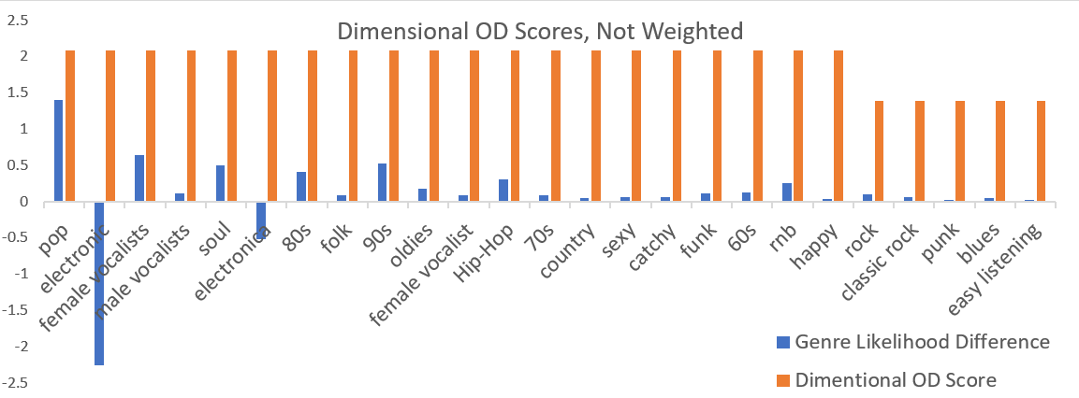
Unweighted Results
__________________________________________________________________________________________
For the only female-vocalist song in an instrumental album:
Before weighting, genre OD scores contributes relatively the same
Feature with minor difference can result in high OD score (eg. male vocalists)
Dian Yuan
Notes:
Let’s look into this example, a song with female-vocalist in a purely instrumental album. Before weighting, minor genre likelihood difference can contribute as much dimensional OD scores as the major ones. Like the fourth column “male-vocalist” here.

Slide 30
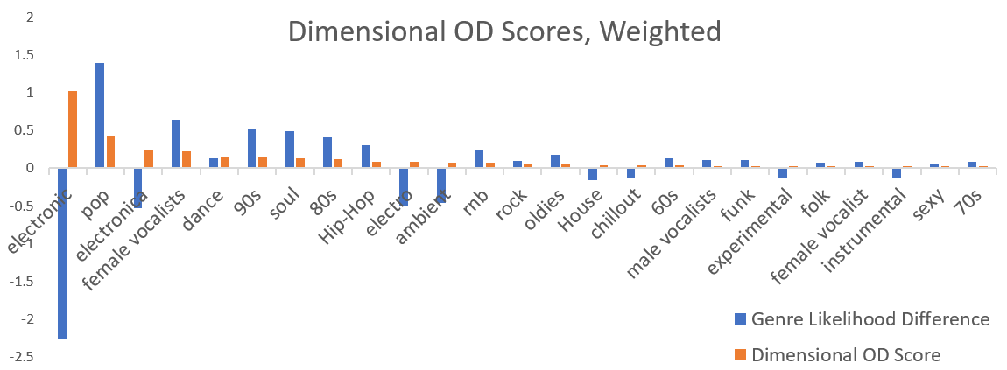
Weighted Results
__________________________________________________________________________________________
For the only female-vocalist song in an instrumental album:
After weighting, larger genre difference results in higher OD Score
Dian Yuan
Notes:
After weighting, larger genre difference results in higher dimensional OD score, and the outcomes looks much more reasonable.

Slide 31
Audio Application: Conclusion
__________________________________________________________________________________________
Don’t expect good performance on mining latent high-level feature with
pure statistical methods like COPOD
Although might not be the best choice, COPOD can be worth a try
for postprocessing tasks in all kinds of fields
Easy to implement, fast prototyping
Computationally efficient fitting
Some explainability and extensibility
Dian Yuan
Notes:
To conclude, we have learned two points during the audio application. First, we should not expect good performance on mining latent high-level feature with pure statistical methods like COPOD. Second, although it might not be the best choice, COPOD can be worth trying for postprocessing tasks in all kinds of fields. Because its’ easy to implement, good for fast prototyping. Its fitting is also computationally efficient. And the dimensional OD scores can provide some explainability and extensibility, like what we have done in the weighting.

Slide 32
Text outlier detection
__________________________________________________________________________________________
Steps:
Vectorize
training the dataset
- giving labels to the training set and test set
make COPOD fit the model
feed the test set
Ximeng Yu
Notes:
Let get started of my part. My main job is to explore what COPOD can do for the text outlier detection. The first thing I would like to introduce is how we implement COPOD on this direction. Here are some steps. It is actually pretty straightforward. COPOD will give us a score about its performance

Slide 33
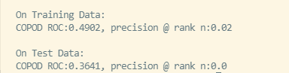
Naive testing
__________________________________________________________________________________________
Outlier detection of emotion of twitter comments：
tf-idf vectorization
Using labeled dataset
Precision score is almost 0
Ximeng Yu
Notes:
After we understand the basic ideas, let us talk about the first test we have done. For this test, The goal is to detect the positive twitter comments as outlier from a dataset which contains lots of negative comments. In this case, we implement tf-idf algorithm to vectorize the text. To be more specific, this algorithm will convert a comment to a huge vector and most of elements in this vector will be zeros. However, the result is very poor. As you can see here, COPOD gave us a zero score on the precision.

Slide 34
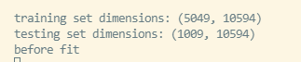
Why we failed?
__________________________________________________________________________________________
Too many dimensions?
There is about 10594 dimensions for training and testing set
The way we vectorize the text is too simple？
Using tf-idf vectorizaion will cause the information become Sparse
Improvement of vectorization method
Implementing SentenceVector
Ximeng Yu
Notes:
So, here is the problem. Why we failed? After the discussion with my partners, we have three guesses. The first guess is COPOD may not be able to deal with the high dimensional data. However, it does not make any sense. because my partner jinjian tong needs to deal with pictures and those vectorized pictures contain even more dimensions than the vectors I have.. So, we move to our next reasonable guess which is we might implement improper vectorization method. Tf-idf might be too simple to extract all the useful information. So, COPOD cannot understand the difference between the inlier and the outlier. How can we solve this problem? After doing some search, we found a tool which is called Sentence Vector. Basically, sentence vector is a pre-trained model and it also can convert the text to a vector. The difference between tf-idf algorithm and Sentence vector is that Sentence vector will map each sentence into vector space and two vectors will close to each other if those two sentenced have similar meaning. It might be helpful for COPOD to understand which sentence are related.

Slide 35
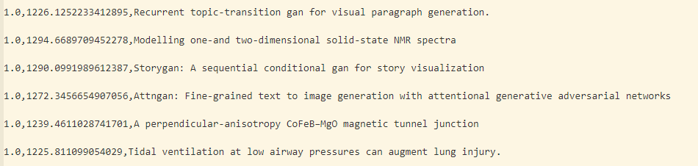
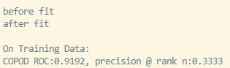
Why we failed
__________________________________________________________________________________________
Is there any problem with our dataset?
Improvement of dataset
- More related goal and dataset
Ximeng Yu
Notes:
At this point, a similar idea came in and leading us our third guess. Is it possible that our dataset contains too much information, so that the characteristics of the information we want is not obvious. In other words, COPOD may not figure out the relationship between the information of dataset and our goals. So the second change we made is that we switch our dataset from twitter comments to academic papers. In this case, the titles that from the same field will be treated as inlier and the other paper will be the outliers. Here are some examples, our dataset is mainly about COVID 19 now. And most of papers from the dataset was detected as inliers. I did not show them all here because of the space limitation. The last five titles are manually added chaos and they were all detected as outliers.

Slide 36
Text Application: Conclusion
__________________________________________________________________________________________
Using COPOD to detect outlier from raw text data is almost impossible
COPOD can be used to detect outliers from highly relevant texts
e.g. Papers about COVID-19 and GAN
But it cannot figure out the difference between COVID-19 and flu
Ximeng Yu
Notes:
At the end, here are some conclusions. Using COPOD to detect outlier from raw text data is almost impossible. And the second thing is COPOD can be used to detect outliers from highly relevant texts. For example, as I mentioned before, COPOD can figure out the difference between COVID 19 and GAN. But it do not know the difference between the COVID 19 and flu

Slide 37
Thanks for watching
Questions ?

